Slide 1
Web Content Management
Creating Content-Centric Sites with SharePoint Server 2010
Notes:
In this module you will learn how to use the Publishing capabilities in SharePoint Server 2010 to create content-centric sites, empowering content owners to update sites without involving the IT group every time changes need to happen.

Slide 2
Agenda
Overview of WCM in SharePoint
Components of a Publishing Page
Authoring and Publishing Process
Roll Up Content with Content Query Web Part
Content Deployment
Multilingual Solutions (Variations)

Slide 3
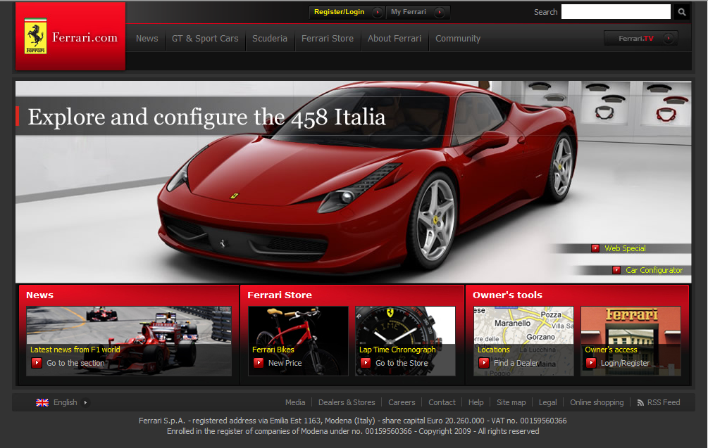
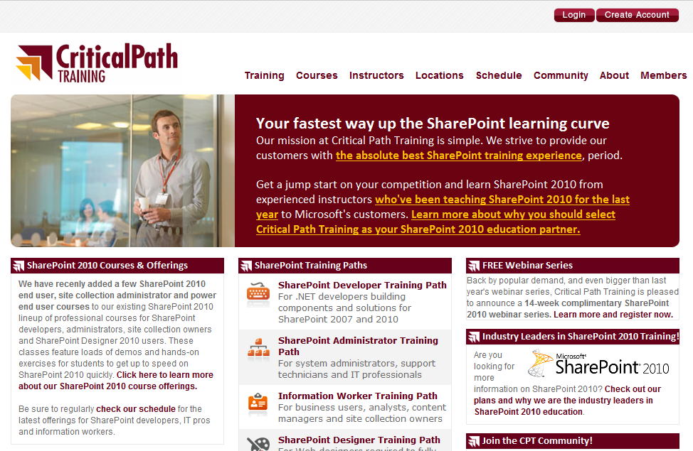
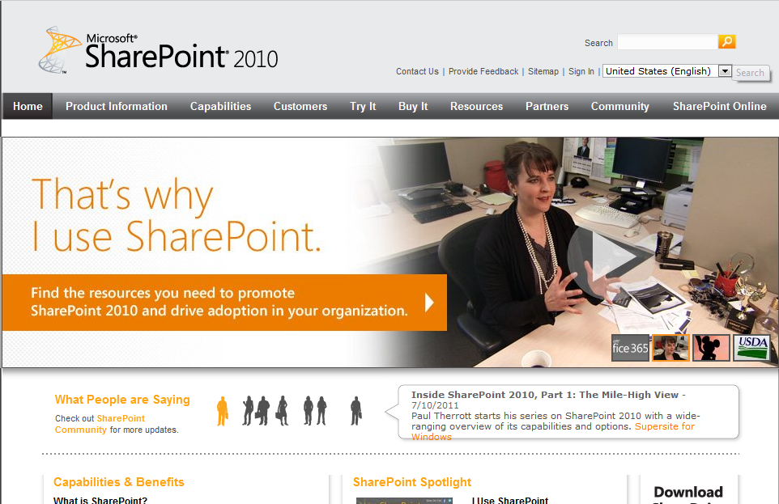
Create Flashy and Content-Centric Sites
Notes:
From extremely flashy sites to very content rich functional Web sites, Web Content Management (WCM) can handle it all. They power many large intranet sites around the world (including Microsoft themselves). The WCM components in SharePoint 2010 can be dialed up or down depending on how much customization/functionality is required.

Slide 4
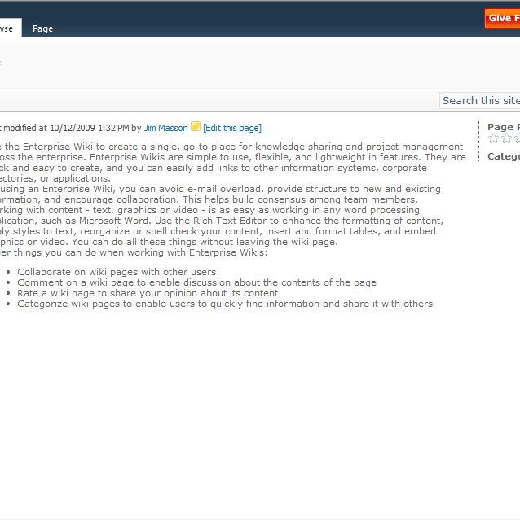
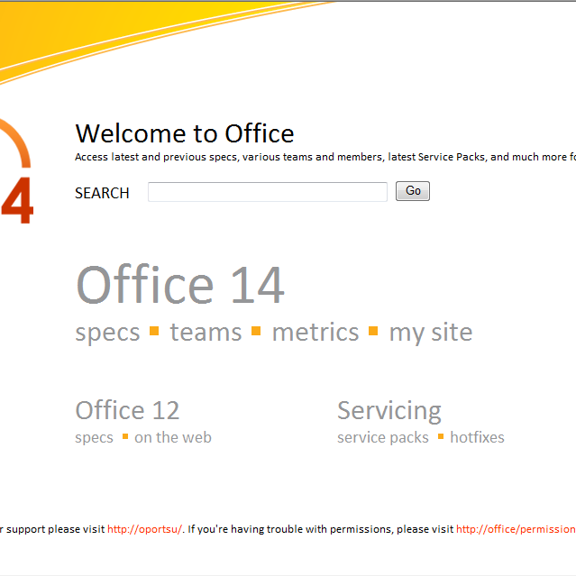
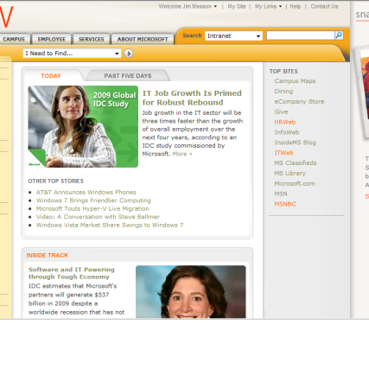


The Many Shades of WCM
Enterprise Wiki
Divisional Portal
Corporate Intranet
Internet
No approval
Many authors
Unstructured
Lightly branded
Fewer authors
Lightweight approval
Simple workflow
Branded with custom master page
Highly controlled publishing
Structured Content
Pixel perfect branding
Flexible WCM Platform · Adjustable Governance · Community Involvement
Notes:
The content publishing can be very simple or highly controlled with a formal publishing process and multiple workflows.
You decide the right level of branding, authoring, constraints and process.

Slide 5
ABC’s of Web Content Management
Authoring – empowering content owners
Web-based authoring experience
Word / InfoPath authoring experience
Branding – enforcing consistent user experience
Master pages & page layouts
Controlled Publishing – enforcing rules & policies
Controlling who can author content & where
Controlling who can approve & publishing
Notes:
Authoring Experience
Benefits from the UX improvements
One-click page authoring
Automatic check for unpublished items and spell checking
HTML Editor
Cross browser, tight integration with Ribbon for extensibility
Web Asset Editor
Easy to find, sort and view assets
No dialog refresh (only content area)
Integrates with Asset Library (ECM)
Embedded Video
Stored in SQL / external BLOB
Skinable Silverlight plugin

Slide 6
Social, Taxonomy & Rich Media
Ratings
Assign page a score of 1-5
Metadata
Taxonomy vs. Folksonomy
Tagging & Keywords
Included OOTB
Silverlight Web Part
Video Streaming
Site Asset Library
Digital Asset Manager
Notes:
Rating a piece of content helps to tell other users which content you found useful. You can rate any publishing page with a rating of 1 to 5.
Taxonomy is used to classify things.
Folksonomy is the method used to categorize content collaborativelyusing tags.
There is a significant amount of investment made in providing rich media content directly through SharePoint pages. For example, a Silverlight Web Part which comes OOTB can be used to stream videos that are stored in the built in Site Asset library.

Slide 7
WCM Content Authoring Improvements
Authoring Experience
Benefits from the UX improvements
One-click page authoring
Automatic check for unpublished items
HTML Editor
Cross browser, tight integration with Ribbon for extensibility
Web Asset Editor
Easy to find, sort and view assets
No dialog refresh (only content area)
Integrates with Asset Library (ECM)
Embedded Video
Stored in SQL / external BLOB
Skinable Silverlight plugin
Notes:
The UI implementation is no longer table based and is XHTML compliant.
Authoring in a WCM site is fully integrated in the ribbon.
The number of postbacks and page refreshes has been reduced. Now the only time the page refreshes in the authoring process is when the context of the page changes.
There is now an out of the box Rich Text Editor and is fully cross browser supported. It also generates clean markup.
One-click page authoring: there is no intermediate step anymore where you have to fill out, the name of the page, the URL, the content type and page layout. Click Site Actions » New Page and you can start creating your page. Switching to a different content type or page layout, can be done using the ribbon.
The Web Asset Editor makes finding, sorting and viewing assets a lot easier.
There is also Embedded Video support with a skinableSilverlight plugin.

Slide 8
WCM Platform Improvements
Large Pages Libraries
MOSS 2007 did not support folders to facilitate large Pages libraries (MSKB #948614)
Folders in Pages libraries now supported
Check for unpublished items
Unpublished content called out when publishing a page
Content Organizer
Notes:
Large Page Libraries can now be better organized as they allow folders now.
There is an automatic check for unpublished items. Now when you publish a page, SharePoint automatically does a spell check on your page as well as analyze it to see if there are any assets referenced in your page that are currently unpublished.
Content Organizer:
You need to setup a few rules on a Publishing site and when new content is saved/published, if it meets the criteria of one of the rules, the content will be automatically moved to the location you specify.
It will help you organizing large page libraries. For example, when a folder already contains 5000 items, the content organizer can create a new folder when the 5001th item is created.
It allows you to automatically route documents to different libraries and folders within those libraries.
the Content Organizer will only work on content types that are or derive from the Document content type.
The Content Organizer is added to SharePoint 2010 as a site feature.

Slide 9
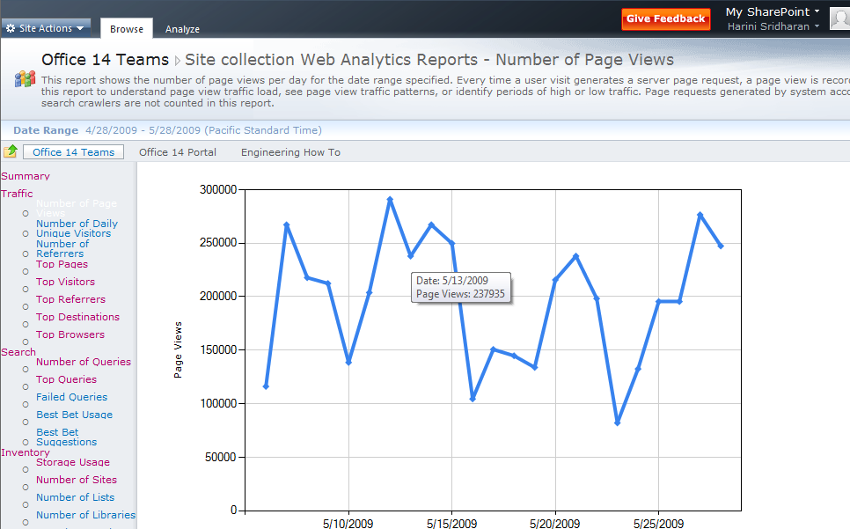
Web Analytics Service Application
Replaces Traditional Usage Analysis
Web Analytics Reports
3 report categories: Traffic, Search, Inventory
3 report levels: Site, Site Collection, Web Application
2 report types: trended, or ranked (Top X)
Web Analytics Workflows
Alert Metric Changes
Schedule Reports
What’s Popular Web Part
Support Popular Content, Search Queries, and Search Results
Notes:
Web analytics replaces the 2007 Usage Analysis:
Provides basic reporting on a SharePoint site.
Users can setup scheduled reports.
OOTB Web Parts help expose popular content.
Not a replacement for larger Web site analytics packages that do things like brand & campaign management.

Slide 10
DEMO
Web Content Management Overview

Slide 11
Agenda
Overview of WCM in SharePoint
Components of a Publishing Page
Authoring and Publishing Process
Roll Up Content with Content Query Web Part
Content Deployment
Multilingual Solutions (Variations)

Slide 12
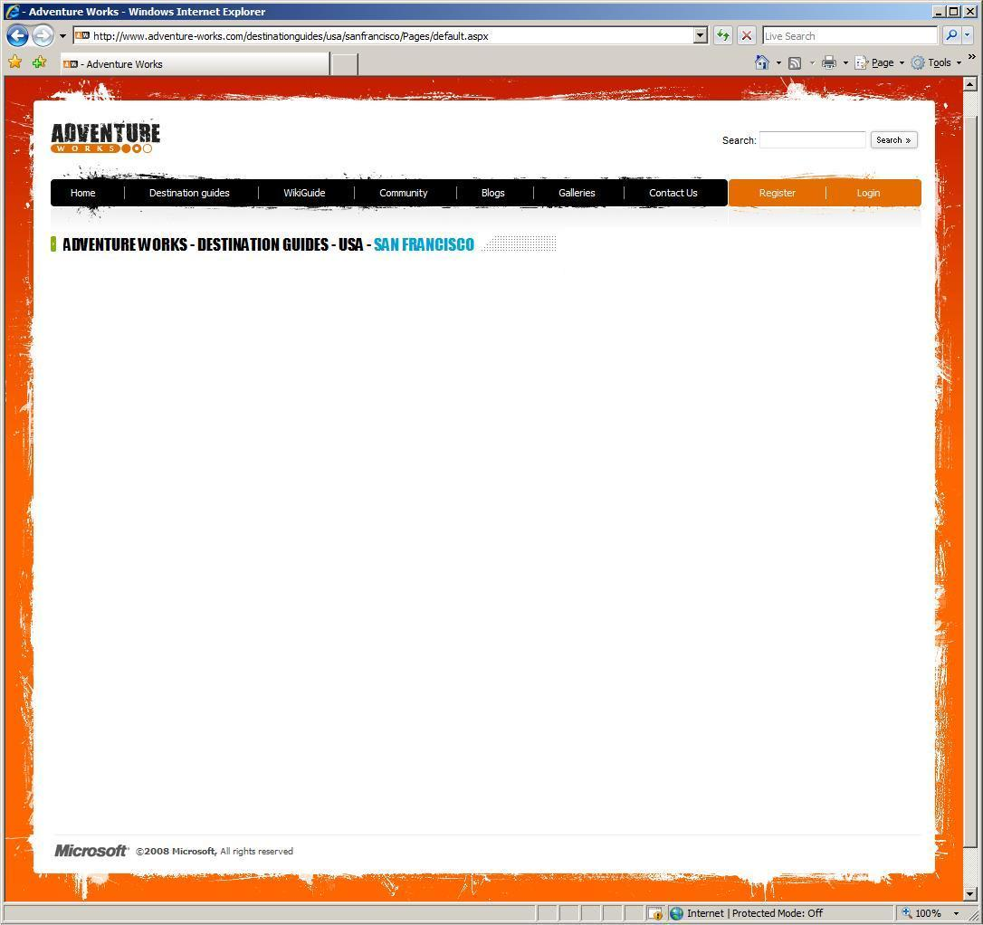
Master Page
Navigation
Logos
Search box
Login control
Editing controls
CSS references
Server controls
Notes:
Master page contains the global branding & controls used throughout the site.

Slide 13
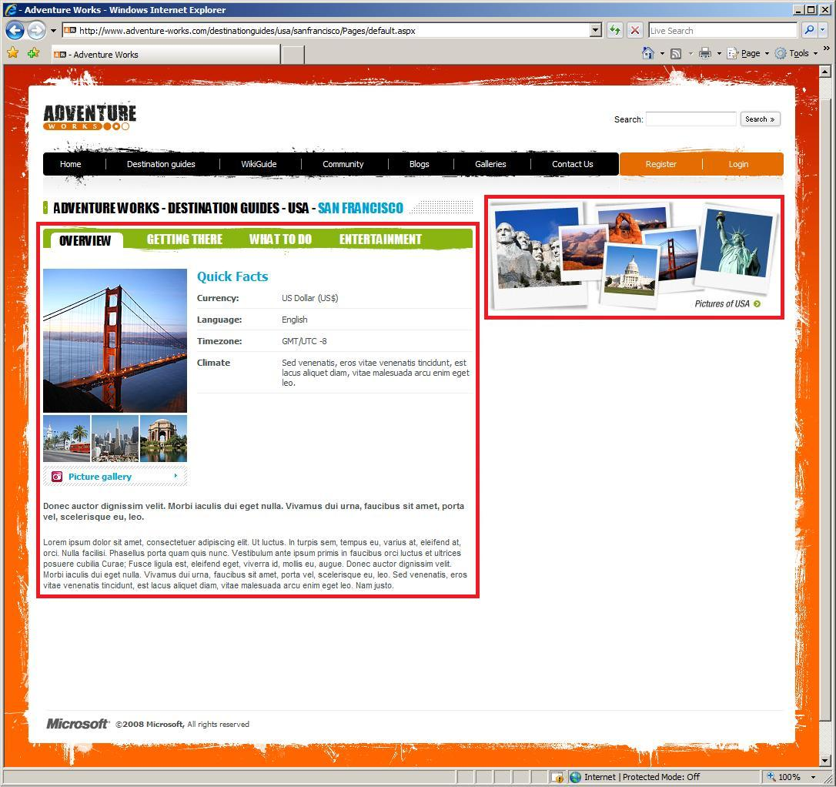
Page Layout
Provide the template for rendering
Reference a master page for navigation and chrome
Define what can be authored in the page
Field Controls
Web Parts
Web Part Zones
Many Layouts per Content Type
Notes:
Page layouts are used to define the different rendering options available for a specific type of a page.

Slide 14
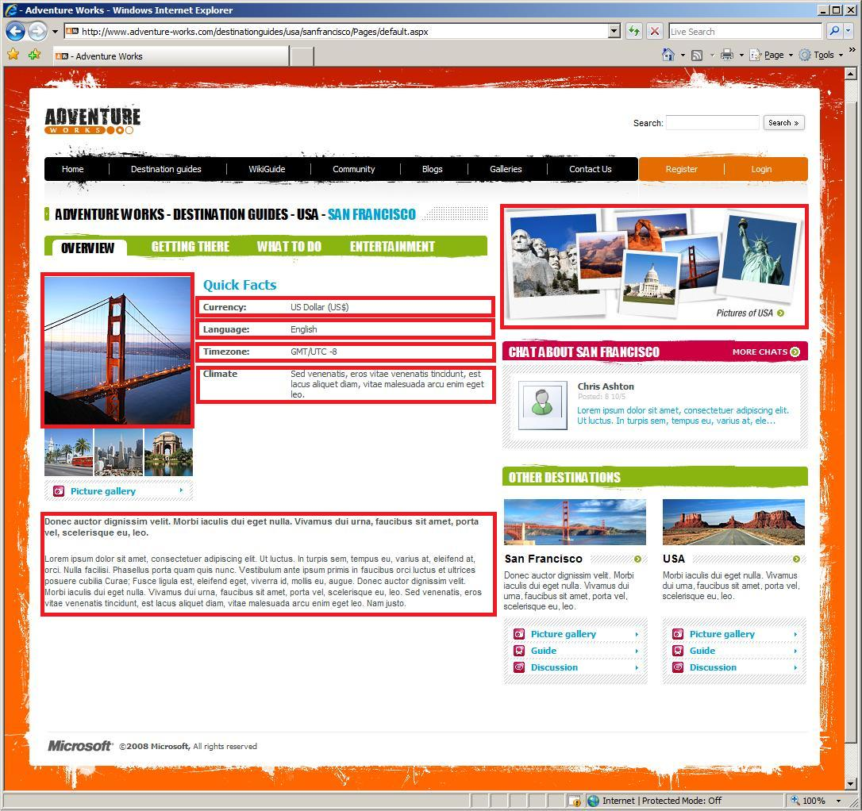
Field Controls
Bind to fields in page content type
Provide control over structure and branding
Restrictions on author options
Notes:
Field controls offer developers/designers explicit control over where content will reside in a site. Content owners/users can’t remove/move these types of controls.

Slide 15
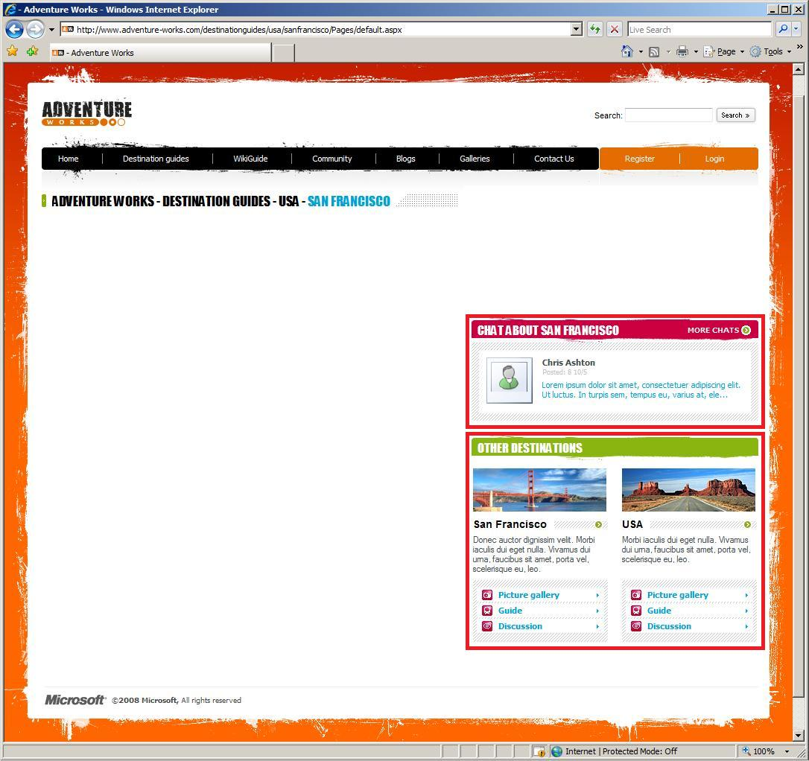
Web Parts
Full Gallery of Controls
Web Part Zones
Authors control selection and placement in Layout
Designers place and configure on users behalf
Notes:
Just like Web Parts in collaboration sites, developers/designers add zones which enable content owners to insert/modify Web Parts with these zones. Doing so yields control of the layout of the page from the development/design staff to the end users (content owners / managers).

Slide 16
Field Controls & Web Parts Compared
 | Field Controls | Web Parts
Content Storage | In a field (column) in the page’s underlying SPListItem | Within the Web Part data of the page
Personalization | No | Yes
Versioning | Versioning tied to page with complete history | Versioning tied to page without history
Who has ultimate control? | Page designer / developer | Page designer (in placement of Web Part zones); content owner in managing of zone’s contents (add/edit Web Parts within Web Part zone)
When to use? | Specific types of content must appear in specified places of a page; structured formatting / branding | Structure of content on page (in part of a page) isn’t important; let content owners have full control

Slide 17
DEMO
Pieces of a Publishing Page

Slide 18
Agenda
Overview of WCM in SharePoint
Components of a Publishing Page
Authoring and Publishing Process
Roll Up Content with Content Query Web Part
Content Deployment
Multilingual Solutions (Variations)

Slide 19
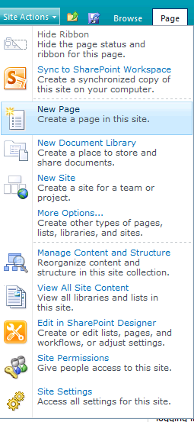
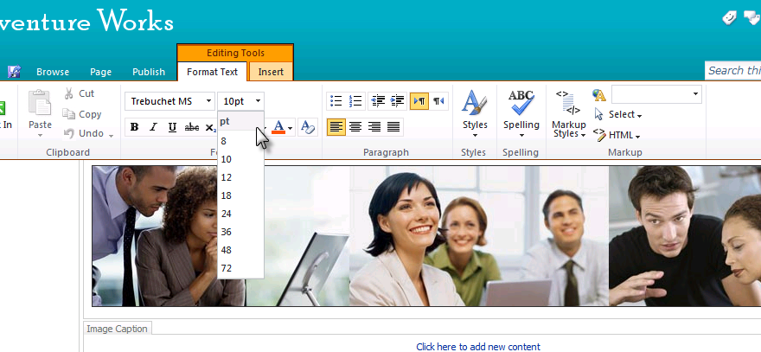
Rich Authoring & Streamlined Editing
Easy Page Creation
Ribbon
Standards like XHTML, WCAG 2.0, x-browser
Notes:
Creating new pages has been streamlined. Unlike in SharePoint 2007, content owners can create a new page from the Site Actions menu and specify a page name without selecting a content type or page layout. SharePoint 2007 required you to select a page type (content type) and page layout at creation time.
Once the page has been created users can then switch between content types & page layouts after the page has been created on the fly using the Page » Page Layout option in the ribbon.
All content authoring controls have been pushed into the ribbon.
The rich text editor is now cross browser and generates well-formed XHTML.
Additional tools in the ribbon (Editing Tools » Format Text) assist with converting HTML to well-formed XHTML.

Slide 20
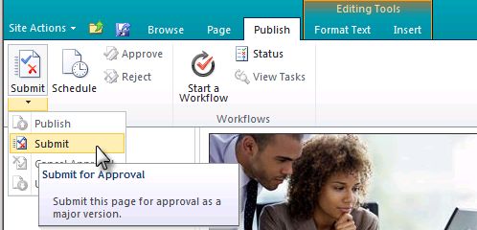
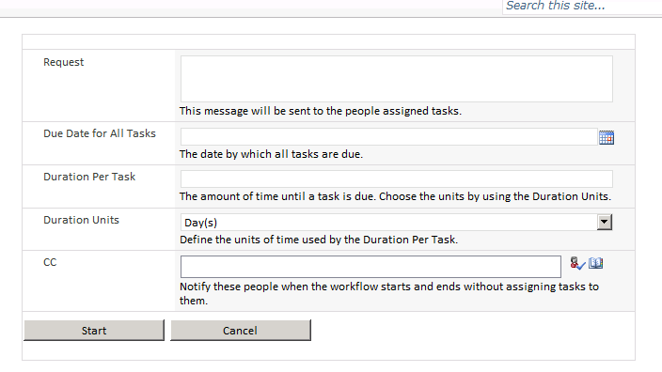
Publication Process
Publish process kicks off the workflow
Notes:
The ‘Publishing Site with Workflow’ site template comes out-of-the-box with a built in workflow called Page Approval which is readily modifiable using the browser.
The base workflow template for this workflow is Publishing Approval workflow which works very similar to the Approval workflow. The Approval workflow is for approving documents while the Publishing Approval workflow acts on pages.

Slide 21
Demo
Author and Publish Pages

Slide 22
Agenda
Overview of WCM in SharePoint
Components of a Publishing Page
Authoring and Publishing Process
Roll Up Content with Content Query Web Part
Content Deployment
Multilingual Solutions (Variations)

Slide 23
Content Query Web Part
Content filters introduced
Filter query results based on query string or current page content values
MOSS 2007 only allowed static filters OOTB
SharePoint Server 2010 adds capability for page authors / designers can select content fields to display via customization IU
In MOSS 2007, developers had to manually specify these fields in the CQWP’s CommonViewFields property & in the XSLT
Notes:
Content filters:
CQWP now supports filtering content based on values in content fields on the current page or from values on the query string.
Content fields (aka: slots):
SharePoint 2007 required developers to manually enter custom content fields to be passed to the CQWP XSLT using the CommonViewFieldsnode.
SharePoint 2010 now lets users pick them in the UI.

Slide 24
DEMO
Content Query Web Part

Slide 25
Agenda
Overview of WCM in SharePoint
Components of a Publishing Page
Authoring and Publishing Process
Roll Up Content with Content Query Web Part
Content Deployment
Multilingual Solutions (Variations)

Slide 26
WCM Content Deployment
Primary MOSS 2007 Issue: export
SharePoint Server 2010 content deployment still has same export process, but alternate method pushed:
SQL Server Database Snapshots
Snapshots available in SQL 2005 & 2008 Enterprise Edition
Snapshot used on the source server to avoid concurrent authoring issues; snapshot not sent to destination for restore purposes
Notes:
Snapshots don’t ‘fix’ content deployment issues, they address a major pain point by creating a point-in-time snapshot that can’t be edited which is then used as the export source of content.
When you are exporting lots of content, and if authoring is happening in the background, it can cause issues with that import and with future ones. If you’re using SQL Server 2005 / 2008 Enterprise Edition, SharePoint Server 2010’s content deployment can now take advantage of database snapshots. The snapshot is used to collect the content and then the package of exported content (not the snapshot) is sent along to the destination box, then the snapshot is discarded. This should affect the majority of those customers who’ve had trouble with massive export packages.

Slide 27
Multilingual Sites
SharePoint 2010 WCM leverages variations, introduced in SharePoint 2007
Variations assist in managing multiple copies of sites where each copy is a translated version of the source site
SharePoint 2010 improvements:
Focus on reliability, manageability and logging
All variation “work” moved to timer jobs
Adding start / stop capability
Notes:
Site variations offer the possibility to support multilingual SharePoint sites. Generally, you use site variations to modify a source site, and Office SharePoint Server 2007 duplicates those modifications to any variations of this site.
In SharePoint 2010 site variations are optimized and improved:
Site variations are more reliable
The variation log details the issues so that they can be addressed and solved.
The work concerning variations that can be done in background, is moved to timer jobs.

Slide 28
Summary
Components of a Publishing Page
Authoring and Publishing Process
Roll Up Content with Content Query Web Part
Content Deployment
Multilingual Solutions (Variations)

